Slide 1
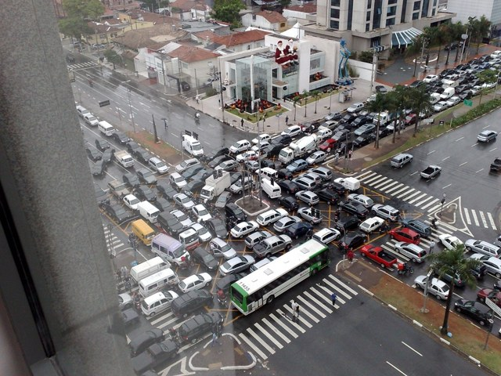
Multiprocessor Synchronization
CSCI 1760
Barrier Synchronization
Lecture 19
November 2023
Maurice Herlihy
Brown University

Slide 2
Simple Video Game
Prepare frame for display
  By graphics coprocessor
“soft real-time” application
Need at least 35 frames/second
OK to mess up rarely

Slide 3
Simple Video Game
while (true) {
frame.prepare();
frame.display();
}

Slide 4
Simple Video Game
while (true) {
frame.prepare();
frame.display();
}
What about overlapping work?
1st thread displays frame, while …
2nd thread prepares next frame

Slide 5
Two-Phase Rendering
while (true) {
if (phase) {
frame[0].display();
} else {
frame[1].display();
}
phase = !phase;
}
while (true) {
if (phase) {
frame[1].prepare();
} else {
frame[0].prepare();
}
phase = !phase;
}

Slide 6
Two-Phase Rendering
while (true) {
if (phase) {
frame[0].display();
} else {
frame[1].display();
}
phase = !phase;
}
while (true) {
if (phase) {
frame[1].prepare();
} else {
frame[0].prepare();
}
phase = !phase;
}

Slide 7
Two-Phase Rendering
while (true) {
if (phase) {
frame[0].display();
} else {
frame[1].display();
}
phase = !phase;
}
while (true) {
if (phase) {
frame[1].prepare();
} else {
frame[0].prepare();
}
phase = !phase;
}
even phases

Slide 8
Two-Phase Rendering
while (true) {
if (phase) {
frame[0].display();
} else {
frame[1].display();
}
phase = !phase;
}
while (true) {
if (phase) {
frame[1].prepare();
} else {
frame[0].prepare();
}
phase = !phase;
}
odd phases

Slide 9
Synchronization Problems
How do threads stay in phase?
Too early?
“we render no frame before its time”
Too late?
Recycle memory before frame is displayed

Slide 10
Ideal Parallel Computation
0
0
0
1
1
1

Slide 11
Ideal Parallel Computation
2
2
2
1
1
1

Slide 12
Real-Life Parallel Computation
0
0
0
1
zzz…
1

Slide 13
Real-Life Parallel Computation
2
zzz…
1
1
0
Uh, oh

Slide 14
Barrier Synchronization
barrier
0
0
0

Slide 15
Barrier Synchronization
barrier
1
1
1

Slide 16
Barrier Synchronization
barrier
Until every thread has left here
No thread enters here

Slide 17
Why Do We Care?
Mostly of interest to
Scientific computation
Other applications
Garbage collection
Less common in systems

Slide 18
Duality
Dual problem to mutual exclusion
Include others, not exclude them
Similar issues
Interaction with caches …
invalidation
spinning

Slide 19
Example: Parallel Prefix
a
b
c
d
before
a
a+b
a+b+c
a+b+c
+d
after

Slide 20
Parallel Prefix
One thread
Per entry
a
b
c
d

Slide 21
Parallel Prefix: Phase 1
a
b
c
d
a
a+b
b+c
c+d

Slide 22
Parallel Prefix: Phase 2
a
b
c
d
a
a+b
a+b+c
a+b+c
+d

Slide 23
Parallel Prefix
N synchronous threads can compute
Parallel prefix
Of N entries
In log₂ N rounds
What if system is asynchronous?
Why we need barriers

Slide 24
Prefix
Parallel Prefix
class Prefix extends Thread {
int[] a;
int i;
Barrier b;
void Prefix(int[] a,
Barrier b, int i) {
a = a;
b = b;
i = i;
}

Slide 25
Parallel Prefix
class Prefix extends Thread {
int[] a;
int i;
Barrier b;
void Prefix(int[] a,
Barrier b, int i) {
a = a;
b = b;
i = i;
}
Array of input values

Slide 26
Prefix
Parallel Prefix
class Prefix extends Thread {
int[] a;
int i;
Barrier b;
void Prefix(int[] a,
Barrier b, int i) {
a = a;
b = b;
i = i;
}
Thread index

Slide 27
Prefix
Parallel Prefix
class Prefix extends Thread {
int[] a;
int i;
Barrier b;
void Prefix(int[] a,
Barrier b, int i) {
a = a;
b = b;
i = i;
}
Shared barrier

Slide 28
Prefix
Parallel Prefix
class Prefix extends Thread {
int[] a;
int i;
Barrier b;
void Prefix(int[] a,
Barrier b, int i) {
a = a;
b = b;
i = i;
}
Initialize fields

Slide 29
Where Do the Barriers Go?
Parallel Prefix
public void run() {
int d = 1, sum = 0;
while (d < N) {
if (i >= d)
sum = a[i-d];
if (i >= d)
a[i] += sum;
d = d * 2;
}}}

Slide 30
Where Do the Barriers Go?
Parallel Prefix
public void run() {
int d = 1, sum = 0;
while (d < N) {
if (i >= d)
sum = a[i-d];
b.await();
if (i >= d)
a[i] += sum;
d = d * 2;
}}}
Make sure everyone reads before anyone writes

Slide 31
Where Do the Barriers Go?
Parallel Prefix
public void run() {
int d = 1, sum = 0;
while (d < N) {
if (i >= d)
sum = a[i-d];
b.await();
if (i >= d)
a[i] += sum;
b.await();
d = d * 2;
}}}
Make sure everyone reads before anyone writes
Make sure everyone writes before anyone reads

Slide 32
Barrier Implementations
Cache coherence
Spin on locally-cached locations?
Spin on statically-defined locations?
Latency?
How many steps?
Symmetry?
Do all threads do the same thing?

Slide 33
Barriers
public class Barrier {
AtomicInteger count;
int size;
public Barrier(int n){
count = AtomicInteger(n);
size = n;
}
public void await() {
if (count.getAndDecrement()==1) {
count.set(size);
} else {
while (count.get() != 0);
}}}}

Slide 34
Barriers
public class Barrier {
AtomicInteger count;
int size;
public Barrier(int n){
count = AtomicInteger(n);
size = n;
}
public void await() {
if (count.getAndDecrement()==1) {
count.set(size);
} else {
while (count.get() != 0);
}}}}
Number of threads not yet arrived

Slide 35
Barriers
public class Barrier {
AtomicInteger count;
int size;
public Barrier(int n){
count = AtomicInteger(n);
size = n;
}
public void await() {
if (count.getAndDecrement()==1) {
count.set(size);
} else {
while (count.get() != 0);
}}}}
Number of threads participating

Slide 36
Barriers
public class Barrier {
AtomicInteger count;
int size;
public Barrier(int n){
count = AtomicInteger(n);
size = n;
}
public void await() {
if (count.getAndDecrement()==1) {
count.set(size);
} else {
while (count.get() != 0);
}}}}
Initialization

Slide 37
Barriers
public class Barrier {
AtomicInteger count;
int size;
public Barrier(int n){
count = AtomicInteger(n);
size = n;
}
public void await() {
if (count.getAndDecrement()==1) {
count.set(size);
} else {
while (count.get() != 0);
}}}}
Principal method

Slide 38
Barriers
public class Barrier {
AtomicInteger count;
int size;
public Barrier(int n){
count = AtomicInteger(n);
size = n;
}
public void await() {
if (count.getAndDecrement()==1) {
count.set(size);
} else {
while (count.get() != 0);
}}}}
If I’m last, reset count for next time

Slide 39
Barriers
public class Barrier {
AtomicInteger count;
int size;
public Barrier(int n){
count = AtomicInteger(n);
size = n;
}
public void await() {
if (count.getAndDecrement()==1) {
count.set(size);
} else {
while (count.get() != 0);
}}}}
Otherwise, wait for everyone else

Slide 40
Barriers
public class Barrier {
AtomicInteger count;
int size;
public Barrier(int n){
count = AtomicInteger(n);
size = n;
}
public void await() {
if (count.getAndDecrement()==1) {
count.set(size);
} else {
while (count.get() != 0);
}}}}
What’s wrong with this protocol?

Slide 41
Reuse
Barrier b = new Barrier(n);
while ( mumble() ) {
work();
b.await()
}
do work
synchronize
repeat

Slide 42
Barriers
public class Barrier {
AtomicInteger count;
int size;
public Barrier(int n){
count = AtomicInteger(n);
size = n;
}
public void await() {
if (count.getAndDecrement()==1) {
count.set(size);
} else {
while (count.get() != 0);
}}}}

Slide 43
Barriers
public class Barrier {
AtomicInteger count;
int size;
public Barrier(int n){
count = AtomicInteger(n);
size = n;
}
public void await() {
if (count.getAndDecrement()==1) {
count.set(size);
} else {
while (count.get() != 0);
}}}}
Waiting for Phase 1 to finish

Slide 44
Barriers
Phase 1 is so over
public class Barrier {
AtomicInteger count;
int size;
public Barrier(int n){
count = AtomicInteger(n);
size = n;
}
public void await() {
if (count.getAndDecrement()==1) {
count.set(size);
} else {
while (count.get() != 0);
}}}}
Waiting for Phase 1 to finish

Slide 45
Barriers
Prepare for phase 2
public class Barrier {
AtomicInteger count;
int size;
public Barrier(int n){
count = AtomicInteger(n);
size = n;
}
public void await() {
if (count.getAndDecrement()==1) {
count.set(size);
} else {
while (count.get() != 0);
}}}}
Waiting for Phase 1 to finish

Slide 46
Uh-Oh
Waiting for Phase 2 to finish
public class Barrier {
AtomicInteger count;
int size;
public Barrier(int n){
count = AtomicInteger(n);
size = n;
}
public void await() {
if (count.getAndDecrement()==1) {
count.set(size);
} else {
while (count.get() != 0);
}}}}
Waiting for Phase 1 to finish

Slide 47
Basic Problem
One thread “wraps around” to start phase
While another thread is still waiting for that phase
One solution:
Always use two barriers

Slide 48
Sense-Reversing Barriers
public class Barrier {
AtomicInteger count;
int size;
volatile boolean sense = false;
threadSense = new ThreadLocal<boolean>…
public void await {
boolean mySense = threadSense.get();
if (count.getAndDecrement()==1) {
count.set(size); sense = mySense
} else {
while (sense != mySense) {}
}
threadSense.set(!mySense)}}}

Slide 49
Sense-Reversing Barriers
public class Barrier {
AtomicInteger count;
int size;
volatile boolean sense = false;
threadSense = new ThreadLocal<boolean>…
public void await {
boolean mySense = threadSense.get();
if (count.getAndDecrement()==1) {
count.set(size); sense = mySense
} else {
while (sense != mySense) {}
}
threadSense.set(!mySense)}}}
Odd or even-numbered phase completed?
Notes:
Sense must be volatile because of Java memory model so that JIT does not remove loop spinning on sense

Slide 50
Sense-Reversing Barriers
public class Barrier {
AtomicInteger count;
int size;
volatile boolean sense = false;
threadSense = new ThreadLocal<boolean>…
public void await {
boolean mySense = threadSense.get();
if (count.getAndDecrement()==1) {
count.set(size); sense = mySense
} else {
while (sense != mySense) {}
}
threadSense.set(!mySense)}}}
Remember sense for next phase

Slide 51
Sense-Reversing Barriers
public class Barrier {
AtomicInteger count;
int size;
volatile boolean sense = false;
threadSense = new ThreadLocal<boolean>…
public void await {
boolean mySense = threadSense.get();
if (count.getAndDecrement()==1) {
count.set(size); sense = mySense
} else {
while (sense != mySense) {}
}
threadSense.set(!mySense)}}}
Get new sense determined by last phase

Slide 52
Sense-Reversing Barriers
public class Barrier {
AtomicInteger count;
int size;
volatile boolean sense = false;
threadSense = new ThreadLocal<boolean>…
public void await {
boolean mySense = threadSense.get();
if (count.getAndDecrement()==1) {
count.set(size); sense = mySense
} else {
while (sense != mySense) {}
}
threadSense.set(!mySense)}}}
If I’m last, reverse sense for next time

Slide 53
Sense-Reversing Barriers
public class Barrier {
AtomicInteger count;
int size;
volatile boolean sense = false;
threadSense = new ThreadLocal<boolean>…
public void await {
boolean mySense = threadSense.get();
if (count.getAndDecrement()==1) {
count.set(size); sense = mySense
} else {
while (sense != mySense) {}
}
threadSense.set(!mySense)}}}
Otherwise, wait for sense to flip

Slide 54
Sense-Reversing Barriers
public class Barrier {
AtomicInteger count;
int size;
volatile boolean sense = false;
threadSense = new ThreadLocal<boolean>…
public void await {
boolean mySense = threadSense.get();
if (count.getAndDecrement()==1) {
count.set(size); sense = mySense
} else {
while (sense != mySense) {}
}
threadSense.set(!mySense)}}}
Reverse sense for next phase

Slide 55
Combining Tree Barriers
2-barrier
2-barrier
2-barrier

Slide 56
Combining Tree Barriers
2-barrier
2-barrier
2-barrier

Slide 57
Combining Tree Barrier
public class Node{
AtomicInteger count; int size;
Node parent; volatile boolean sense;
public void await() {…
if (count.getAndDecrement()==1) {
if (parent != null)
parent.await()
count.set(size);
sense = mySense
} else {
while (sense != mySense) {}
}…}}}

Slide 58
Combining Tree Barrier
public class Node{
AtomicInteger count; int size;
Node parent; volatile boolean sense;
public void await() {…
if (count.getAndDecrement()==1) {
if (parent != null)
parent.await()
count.set(size);
sense = mySense
} else {
while (sense != mySense) {}
}…}}}
Parent barrier in tree

Slide 59
Combining Tree Barrier
public class Node{
AtomicInteger count; int size;
Node parent; volatile boolean sense;
public void await() {…
if (count.getAndDecrement()==1) {
if (parent != null)
parent.await()
count.set(size);
sense = mySense
} else {
while (sense != mySense) {}
}…}}}
Am I last?

Slide 60
Combining Tree Barrier
public class Node{
AtomicInteger count; int size;
Node parent; volatile boolean sense;
public void await() {…
if (count.getAndDecrement()==1) {
if (parent != null)
parent.await()
count.set(size);
sense = mySense
} else {
while (sense != mySense) {}
}…}}}
Proceed to parent barrier

Slide 61
Combining Tree Barrier
public class Node{
AtomicInteger count; int size;
Node parent; volatile boolean sense;
public void await() {…
if (count.getAndDecrement()==1) {
if (parent != null)
parent.await()
count.set(size);
sense = mySense
} else {
while (sense != mySense) {}
}…}}}
Prepare for next phase

Slide 62
Combining Tree Barrier
public class Node{
AtomicInteger count; int size;
Node parent; volatile boolean sense;
public void await() {…
if (count.getAndDecrement()==1) {
if (parent != null)
parent.await()
count.set(size);
sense = mySense
} else {
while (sense != mySense) {}
}…}}}
Notify others at this node

Slide 63
Combining Tree Barrier
public class Node{
AtomicInteger count; int size;
Node parent; volatile boolean sense;
public void await() {…
if (count.getAndDecrement()==1) {
if (parent != null)
parent.await()
count.set(size);
sense = mySense
} else {
while (sense != mySense) {}
}…}}}
I’m not last, so wait for notification

Slide 64
Combining Tree Barrier
No sequential bottlenecks
parallel getAndDecrement() calls
Low memory contention
For same reason
Cache behavior?
Local spinning for bus-based arch
Not so good for NUMA

Slide 65
Remarks
Everyone spins on sense field
Good for bus-based: local spin
Bad for distributed: network hot-spot
Not really scalable

Slide 66
Tournament Tree Barrier
If tree nodes have fan-in 2
No need to call getAndDecrement()
Winner chosen statically
At level i
If i ^{th} bit of ID is 0, move up
Otherwise, keep back

Slide 67
Tournament Tree Barriers
root
winner
loser
winner
loser
winner
loser

Slide 68
Tournament Tree Barriers
All flags blue

Slide 69
Tournament Tree Barriers
Loser thread sets winner’s flag

Slide 70
Tournament Tree Barriers
Loser spins on own flag

Slide 71
Tournament Tree Barriers
Winner spins on own flag

Slide 72
Tournament Tree Barriers
Winner sees own flag, moves up, spins

Slide 73
Tournament Tree Barriers
Bingo!

Slide 74
Tournament Tree Barriers
Sense-reversing: next time use blue flags

Slide 75
Tournament Barrier
class TBarrier {
volatile boolean flag;
TBarrier partner;
TBarrier parent;
boolean top;
…
}

Slide 76
Tournament Barrier
class TBarrier {
volatile boolean flag;
TBarrier partner;
TBarrier parent;
boolean top;
…
}
Notifications delivered here

Slide 77
Tournament Barrier
class TBarrier {
volatile boolean flag;
TBarrier partner;
TBarrier parent;
boolean top;
…
}
Other thread at same level

Slide 78
Tournament Barrier
class TBarrier {
volatile boolean flag;
TBarrier partner;
TBarrier parent;
boolean top;
…
}
Parent (winner) or null (loser)

Slide 79
Tournament Barrier
class TBarrier {
volatile boolean flag;
TBarrier partner;
TBarrier parent;
boolean top;
…
}
Am I the root?

Slide 80
Tournament Barrier
void await(boolean mySense) {
if (top) {
return;
} else if (parent != null) {
while (flag != mySense) {};
parent.await(mySense);
partner.flag = mySense;
} else {
partner.flag = mySense;
while (flag != mySense) {};
}}}

Slide 81
Tournament Barrier
Current sense
void await(boolean mySense) {
if (top) {
return;
} else if (parent != null) {
while (flag != mySense) {};
parent.await(mySense);
partner.flag = mySense;
} else {
partner.flag = mySense;
while (flag != mySense) {};
}}}
I am the root!

Slide 82
Tournament Barrier
void await(boolean mySense) {
if (top) {
return;
} else if (parent != null) {
while (flag != mySense) {};
parent.await(mySense);
partner.flag = mySense;
} else {
partner.flag = mySense;
while (flag != mySense) {};
}}}
I already won

Slide 83
Tournament Barrier
void await(boolean mySense) {
if (top) {
return;
} else if (parent != null) {
while (flag != mySense) {};
parent.await(mySense);
partner.flag = mySense;
} else {
partner.flag = mySense;
while (flag != mySense) {};
}}}
Wait for partner

Slide 84
Tournament Barrier
void await(boolean mySense) {
if (top) {
return;
} else if (parent != null) {
while (flag != mySense) {};
parent.await(mySense);
partner.flag = mySense;
} else {
partner.flag = mySense;
while (flag != mySense) {};
}}}
Synchronize upstairs

Slide 85
Tournament Barrier
void await(boolean mySense) {
if (top) {
return;
} else if (parent != null) {
while (flag != mySense) {};
parent.await(mySense);
partner.flag = mySense;
} else {
partner.flag = mySense;
while (flag != mySense) {};
}}}
Inform partner

Slide 86
Tournament Barrier
void await(boolean mySense) {
if (top) {
return;
} else if (parent != null) {
while (flag != mySense) {};
parent.await(mySense);
partner.flag = mySense;
} else {
partner.flag = mySense;
while (flag != mySense) {};
}}}
Inform partner
Order is important (why?)

Slide 87
Tournament Barrier
void await(boolean mySense) {
if (top) {
return;
} else if (parent != null) {
while (flag != mySense) {};
parent.await(mySense);
partner.flag = mySense;
} else {
partner.flag = mySense;
while (flag != mySense) {};
}}}
I lost!

Slide 88
Tournament Barrier
void await(boolean mySense) {
if (top) {
return;
} else if (parent != null) {
while (flag != mySense) {};
parent.await(mySense);
partner.flag = mySense;
} else {
partner.flag = mySense;
while (flag != mySense) {};
}}}
Tell partner I’m here

Slide 89
Tournament Barrier
void await(boolean mySense) {
if (top) {
return;
} else if (parent != null) {
while (flag != mySense) {};
parent.await(mySense);
partner.flag = mySense;
} else {
partner.flag = mySense;
while (flag != mySense) {};
}}}
Wait for notification from partner

Slide 90
Remarks
No need for read-modify-write calls
Each thread spins on fixed location
Good for bus-based arch
Good for NUMA arch

Slide 91
Dissemination Barrier
At round i
Thread A notifies thread A+2^{i} (mod n)
Requires log n rounds

Slide 92
Dissemination Barrier
+1
+2
+4

Slide 93
Remarks
Elegant
Good homework problems
Not cache-friendly

Slide 94
Static Tree Barrier
One node per thread, statically assigned
Notes:
We describe the static tree using counters in the nodes but could use simple array of locations, each written by a child, all spun on (repeatedly read) by the parent

Slide 95
Static Tree Barrier
Sense-reversing flag
Art of Multiprocessor Programming
95
Notes:
95
We describe the static tree using counters in the nodes but could use simple array of locations, each written by a child, all spun on (repeatedly read) by the parent

Slide 96
Static Tree Barrier
2
2
0
0
0
Each node has count of missing children
Art of Multiprocessor Programming
96
Notes:
96
We describe the static tree using counters in the nodes but could use simple array of locations, each written by a child, all spun on (repeatedly read) by the parent

Slide 97
Static Tree Barrier
2
Spin until zero …
2
0
0
0
Art of Multiprocessor Programming
97
Notes:
97
We describe the static tree using counters in the nodes but could use simple array of locations, each written by a child, all spun on (repeatedly read) by the parent

Slide 98
Static Tree Barrier
2
2
1
0
My counter is zero, decrement parent
0
0
Art of Multiprocessor Programming
98
Notes:
98
We describe the static tree using counters in the nodes but could use simple array of locations, each written by a child, all spun on (repeatedly read) by the parent

Slide 99
Static Tree Barrier
2
2
1
0
Spin on blue done flag
0
0
Art of Multiprocessor Programming
99
Notes:
99
We describe the static tree using counters in the nodes but could use simple array of locations, each written by a child, all spun on (repeatedly read) by the parent

Slide 100
Static Tree Barrier
1
2
2
1
0
0
0
Art of Multiprocessor Programming
100
Notes:
100
We describe the static tree using counters in the nodes but could use simple array of locations, each written by a child, all spun on (repeatedly read) by the parent

Slide 101
Static Tree Barrier
1
2
2
1
0
0
0
Art of Multiprocessor Programming
101
Notes:
101
We describe the static tree using counters in the nodes but could use simple array of locations, each written by a child, all spun on (repeatedly read) by the parent

Slide 102
Static Tree Barrier
1
2
2
1
0
0
0
Art of Multiprocessor Programming
102
Notes:
102
We describe the static tree using counters in the nodes but could use simple array of locations, each written by a child, all spun on (repeatedly read) by the parent

Slide 103
Static Tree Barrier
1
2
1
0
0
0
0
Art of Multiprocessor Programming
103
Notes:
103
We describe the static tree using counters in the nodes but could use simple array of locations, each written by a child, all spun on (repeatedly read) by the parent

Slide 104
Static Tree Barrier
1
2
1
0
0
0
0
Art of Multiprocessor Programming
104
Notes:
104
We describe the static tree using counters in the nodes but could use simple array of locations, each written by a child, all spun on (repeatedly read) by the parent

Slide 105
Static Tree Barrier
yowzah!
1
0
1
0
0
0
0
Art of Multiprocessor Programming
105
Notes:
105
We describe the static tree using counters in the nodes but could use simple array of locations, each written by a child, all spun on (repeatedly read) by the parent

Slide 106
Static Tree Barrier
yowzah!
1
0
1
0
0
0
0
Art of Multiprocessor Programming
106
Notes:
106
We describe the static tree using counters in the nodes but could use simple array of locations, each written by a child, all spun on (repeatedly read) by the parent

Slide 107
Static Tree Barrier
yowzah!
1
0
1
0
0
0
0
Art of Multiprocessor Programming
107
Notes:
107
We describe the static tree using counters in the nodes but could use simple array of locations, each written by a child, all spun on (repeatedly read) by the parent

Slide 108
Static Tree Barrier
yes!
yes!
1
0
yes!
1
0
0
yes!
0
0
yes!
Art of Multiprocessor Programming
108
Notes:
108
We describe the static tree using counters in the nodes but could use simple array of locations, each written by a child, all spun on (repeatedly read) by the parent

Slide 109
Static Tree Barrier
1
2
1
2
0
0
0
Art of Multiprocessor Programming
109
Notes:
109
We describe the static tree using counters in the nodes but could use simple array of locations, each written by a child, all spun on (repeatedly read) by the parent

Slide 110
Remarks
Very little cache traffic
Minimal space overhead
On message-passing architecture
Send notification and sense down the tree

Slide 111
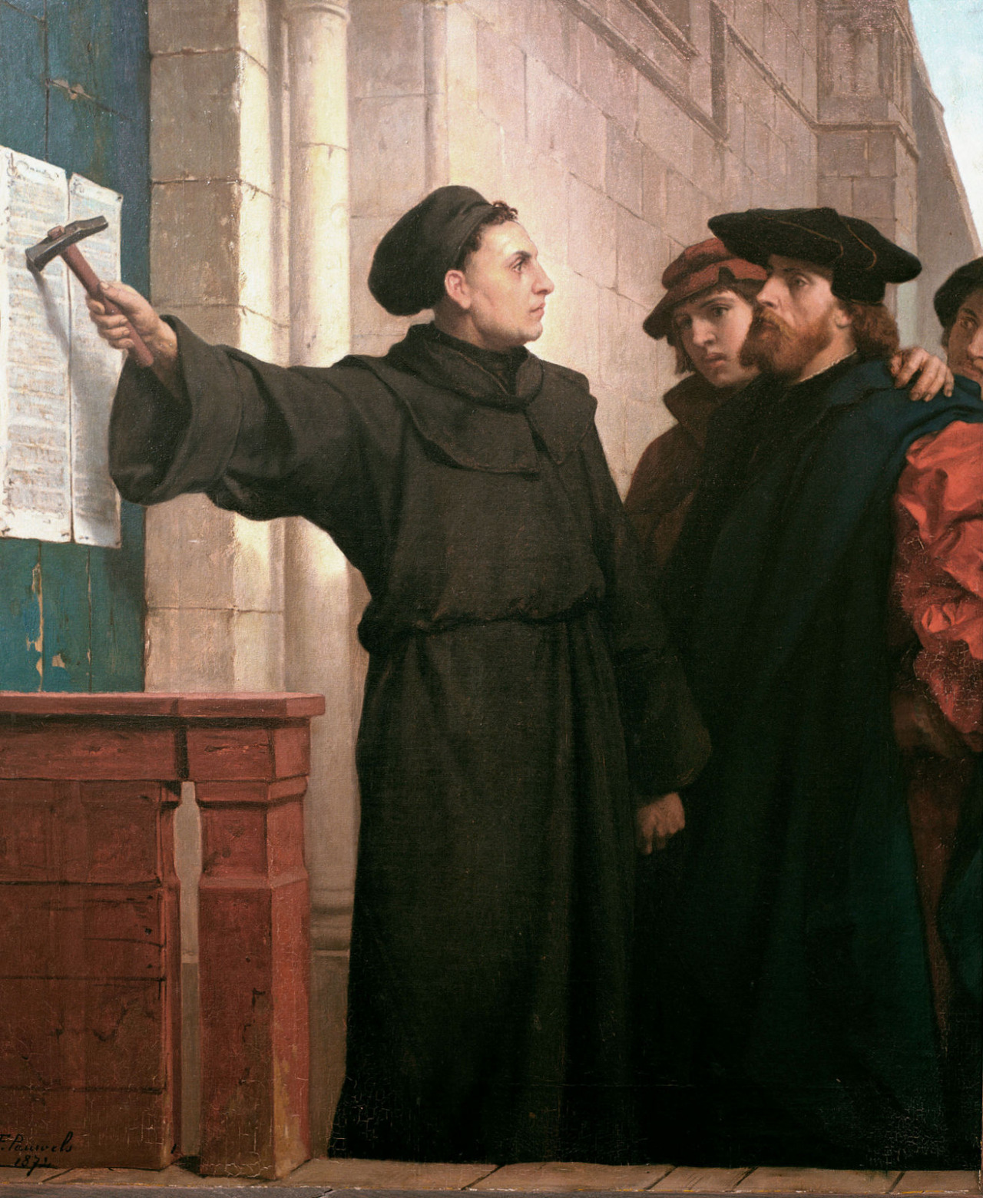
Ideas covered in this lecture
Sense-reversing barriers
Combining trees
Tournament Tree
Dissemination Barrier
Static Tree barrier

Slide 112
This work is licensed under a Creative Commons Attribution-ShareAlike 2.5 License.
You are free:
  to Share — to copy, distribute and transmit the work
  to Remix — to adapt the work
Under the following conditions:
  Attribution. You must attribute the work to “The Art of Multiprocessor Programming” (but not in any way that suggests that the authors endorse you or your use of the work).
  Share Alike. If you alter, transform, or build upon this work, you may distribute the resulting work only under the same, similar or a compatible license.
For any reuse or distribution, you must make clear to others the license terms of this work. The best way to do this is with a link to
  http://creativecommons.org/licenses/by-sa/3.0/.
Any of the above conditions can be waived if you get permission from the copyright holder.
Nothing in this license impairs or restricts the author's moral rights.

Slide 113
one
two
three
four
five

